Slide 1
Towards Optimal Placement of Virtual Network Functions for Reliable and Delay Guaranteed Communications in 5G Networks
By
Sreyashi Mukherjee

Slide 2
Introduction
First Generation (1G) mobile communication network was developed to provide voice service over an analogue network, but without roaming and security features.
Second Generation (2G) mobile network was developed to provide voice service over a digital network with roaming and sufficient security features, and enabled short message service and minimum data service.

Slide 3
Third Generation (3G) mobile network was developed to support multimedia services and to enhance the data rate, service quality, and security.
Fourth Generation (4G) mobile network was developed to support high data rate demands, high mobility and network coverage, and had enhanced security.

Slide 4
Limitations of traditional mobile networks
long design
testing time to bring network functions to market
location dependent functionalities (i.e., migrating network functions is not an easy task without interrupting services), and not being able to support the required.
flexibility and scalability to meet the demands of communication services.

Slide 5
Ways to overcome the previous issues
Mobile communication networks should also support Internet of Things (IoT) devices, machine-to-machine, cyber-physical systems, device-to-device, and vehicle-to everything (vehicle, infrastructure, and pedestrian) communication functionalities in its architectural domain.
As the customers are no longer only human beings but also IoT devices such as cars/vehicles, consumer electronic items, machines, smart devices/sensors, the service requirements (e.g., data rate, availability, and latency) for different applications are highly heterogeneous and depends on the application/service type. So, the previous generations of mobile systems (2G, 3G, and 4G) is no longer suited to efficiently address the diverse service requests with heterogeneous requirements.

Slide 6
Why 5G?
Network operators and service providers are moving towards 5G network:
to increase network flexibility
to meet future demands
to minimize CAPEX and OPEX
to increase revenue by supporting new use cases.
To reduce cost

Slide 7
Utility of 5G
Enhanced multimedia services
very low latency
high reliability
energy saving
high spectrum efficiency
cost reduction
higher system capacity
high user density
high mobility
massive device connectivity.

Slide 8
Characteristics of 5G
It offers new services and enhances the user satisfaction by providing seamless services along with the increased Quality of Experience (QoE).
It enables a fully mobile and connected society.

Slide 9
Categories of 5G
Enhanced Mobile Broadband (eMBB)- Enables to provide very high data rate services on demand.
Ultra-Reliable and Low Latency Communications(URLLC)- Enables to provide latency sensitive and high reliable applications with remote control capabilities.
Massive Machine Type Communications (mMTC)- Enables to connect billions of IoT devices.

Slide 10
5G deployment is able to handle high volumes of data, enhanced capacity, multi-layer network, densification, and heterogeneous environment to support a wide range of use cases and business models. 5G can operate in spectrum of both lower bands (e.g., sub-6 GHz) and higher millimeter wave bands (e.g., 24 GHz and above), enabling high throughput and low latency. 5G New Radio (5G NR) air interface enables mission-critical communications and massive connectivity.

Slide 11
Requirements of 5G
Greater throughput (hundreds of Mbps to tens of Gbps)
high spectrum efficiency (three times higher than 4G)
ultra-low latency (in the order of ms)
ultra-high reliability (up to five nines)
much higher connection density (millions of devices/km2 )
higher mobility range (up to 500 km/h)
high energy efficiency (from both network and user side)
high area traffic capacity (total traffic throughput served per geographic area).

Slide 12
We will see the following:
NFV
SDN
SFC
NS
MEC

Slide 13
Network Functions Virtualization
NFV enables to transfer network functions from dedicated hardware appliances to software-based applications and decouples network functions from specialized hardware appliances using virtualization technique without affecting functionality,
NFV gives network operators the ability to run and consolidate many physical network functions as software modules on top of virtual machines or containers.
The transferred network functions obtained through software virtualization technique are referred as Virtualized Network Functions (VNFs).

Slide 14
Architectural framework of NFV
The NFV consists of the following layers:
NFV Infrastructure (NFVI) layer
VNF layer
Operations/Business Support System (OSS/BSS) layer
Management and Orchestration (MANO) layer

Slide 15
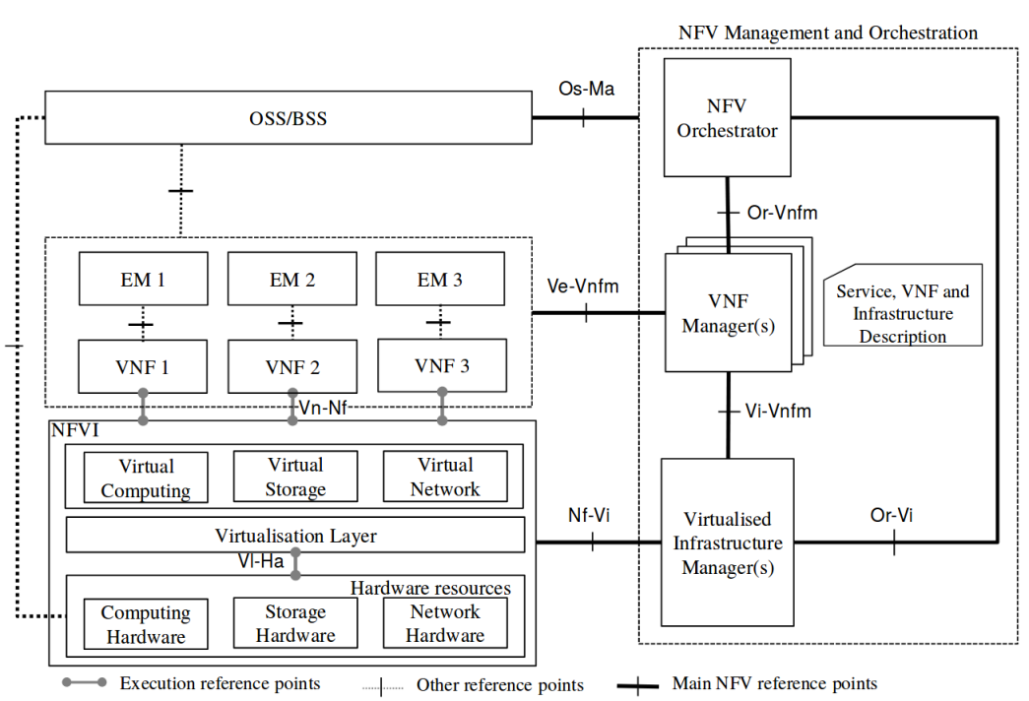
NFV reference architectural framework

Slide 16
Functions
NFVI layer: Both physical and virtual resources reside at the NFVI layer.
Virtualization layer in NFVI is a virtual machine manager or cloud operating system, which is used to virtualize the underlying physical network resources.
MANO layer : Consists of three functional blocks, which are i) Virtual Infrastructure Manager (VIM), ii)VNF Managers (VNFMs), iii) NFV Orchestrator (NFVO).

Slide 17
NFVO is responsible for lifecycle management of network services, management of global resources, network service deployment templates preparation, VNF packages management and their authenticity and integrity, infrastructure resource requests validation and authorization, network service instances performance and policy management, and integrity and visibility of network service instances management.

Slide 18
VNFM controls and manages the lifecycle management of VNF instances and element managers.
VIM controls and manages the infrastructure resources, lifecycle management of software images, collection of performance and fault information of hardware and software resources.

Slide 19
VNF layer – Handles the Virtual Network Fuctions.
Operations/Business Support System (OSS/BSS) layer- takes care of the business or operations related activities.

Slide 20
Software defined Networking
SDN changes the management view of networks by separating the control plane function from the forwarding devices (data plane). The separated control plane function is centralized logically to control multiple networking devices with the help of one or more SDN controllers. SDN enables more flexibility and easy network management.

Slide 21
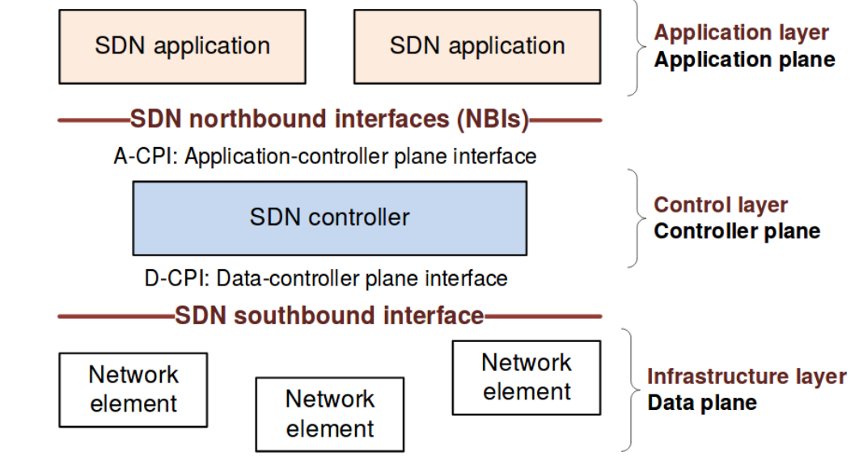
SDN architectural framework

Slide 22
Different layers of SDN
Application layer - hosts applications and relays information between the controller and the applications and policy engines via northbound interface
Controller layer - acts as a network operating system enables network management and control, automation, and policy enforcement across physical and virtual environments
Infrastructure layer- consists of physical networking devices (e.g., routers, switches, and firewall), and it relays information between the controller and the individual networking device via southbound interface.

Slide 23
Service Function Chaining
A Service chain is created to deliver service by deploying the required network functions and connecting them in a sequential order to steer the traffic through them.
Service Function Chaining (SFC) is a mechanism that allows various network functions to be connected in an ordered form to create a service enabling carriers in dynamic manner by using the features of NFV and SDN.
In NFV/SDN enabled 5G networks, SFC can be constructed to provide a specific service by instantiating a set of VNFs (e.g., firewall, network address translator, load balancer, and mobile gateway functions) and steering the traffic flows through them in an ordered manner.

Slide 24
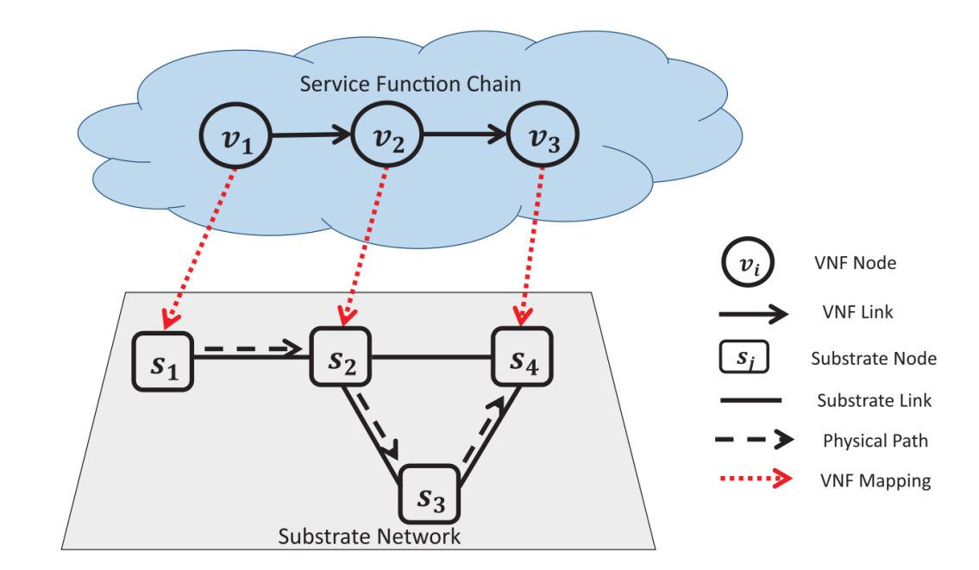
VNF mapping and SFC construction

Slide 25
Network Slicing
Network slicing allows network operators to create multiple dedicated virtual/logical networks (or slices) with the required functionality over a common network infrastructure, and each slice is an isolated and end-to-end virtual network that is tailored to meet the service requirements of a user.
Support multitude of use cases and new services.

Slide 26
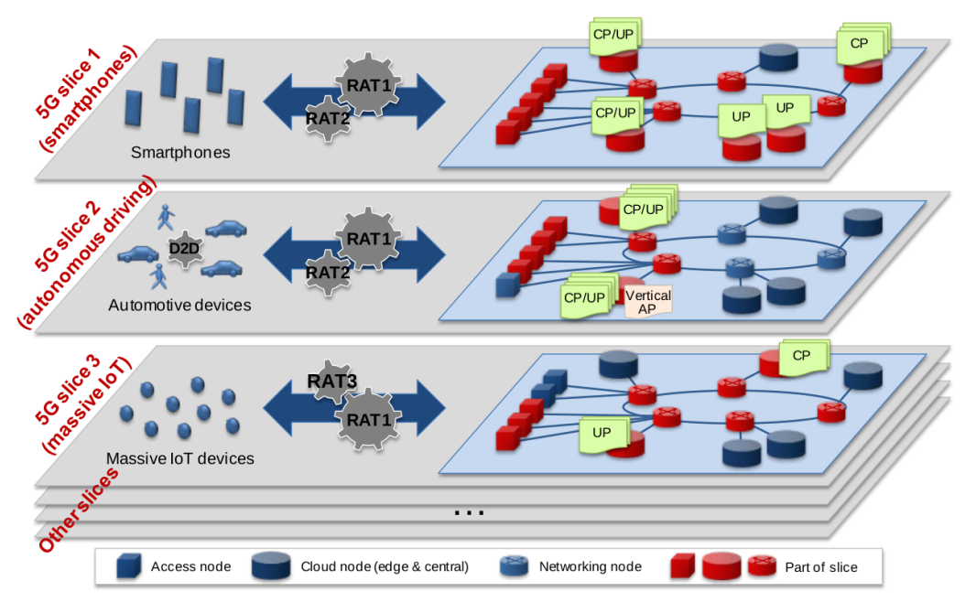
Network slices implemented on a single 5G infrastructure

Slide 27
Multi Access Edge Computing
MEC leverages the features of NFV, SDN, and network slicing to offer delay-sensitive services dynamically as per demand and it has emerged as one of the essential key players for 5G networks and beyond.
MEC is a network architectural model that brings computing, storage, and networking infrastructure closer to the end user or to where the data is generated.
MEC enables to implement MEC applications as software modules on top of virtualization infrastructure (e.g., NFVI), which is located in close proximity to the end user within the Radio Access Network (RAN).

Slide 28
MEC has 3 levels:
system level
host level
network level

Slide 29
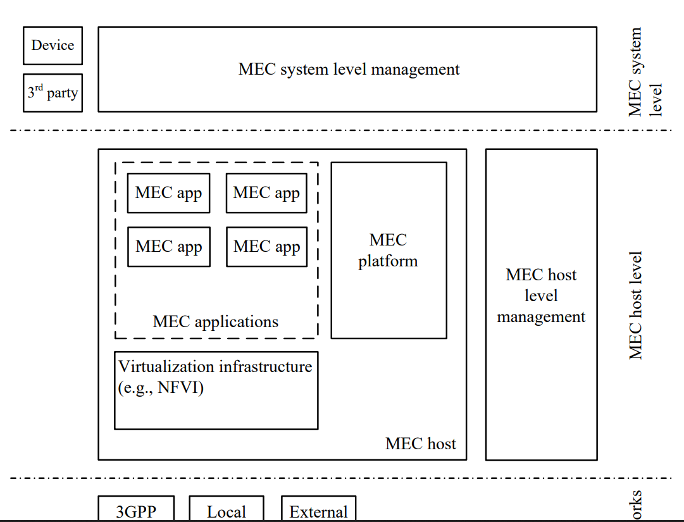
MEC Framework

Slide 30
Functionality
System level-
MEC system level entity includes user devices, 3rd party customers (e.g., commercial enterprises), and MEC system level management functions (e.g., MEC Orchestrator (MECO) and NFVO). MEC system level management functions maintain an overall view of the deployed MEC hosts, available resources, available MEC services, and network topology.
MEC system level management functions coordinate with VIM and VNFM for lifecycle management of MEC applications and MEC platforms.

Slide 31
Host level-
MEC host level entity consists of MEC host level management and MEC host including MEC platform, MEC applications, and virtualization infrastructure.
MEC host level management functions (e.g., VNFM and VIM) handle the management of the MEC specific functionality of a particular MEC host and the applications running on it.

Slide 32
Network level-
MEC network level entity can consist of different networks which could be a subset of operator network or some external network which is allowed to provide service on behalf of the network operator.

Slide 33
Motivation
NFV and SDN support dynamic construction of SFC and network slices and change the way network functions/services are being deployed and managed.

Slide 34
Challenges
Reliability and latency aspects of NFV/SDN enabled 5G networks:
Since network functionality is decoupled from the dedicated hardware appliances and hosted on the generalized servers/switches, logical network components or VNFs are more prone to failure than physical network components.
Failure of a single network component in an SFC can break down the entire service chain and may lead to violation of Service Level Agreements (SLAs) and revenue loss.

Slide 35
Resiliency and latency aspects of NFV and MEC enabled 5G networks:
Delivering services within the stipulated time with high availability and service continuity.
Services failures and consequent downtimes may lead to economic losses, loss of reputation, and even loss of lives.

